Slide 2


R shiny
The Pizza Course Edition
Willem Stolte
Fedor Baart
Lilith Kramer
25 feb 2020

Slide 3
Program
Demo and explanation complex R shiny app (AQMAD)
An introduction to shiny apps
exercise
Demo demo-app
Exploring shiny options
exercise
Debugging
Testing app
Deploying your app
exercise
[dinner 30 min]
Combining Rmarkdown and Rshiny, Shiny server needed
Rplumber
Own project BYOD

Slide 4
Demo AqMad

Slide 5
An introduction to shiny apps
based on https://shiny.rstudio.com/tutorial/

Slide 6
Shiny applications: file structure
ui <- fluidPage(...)
server <- function(input, output){...}
shinyApp(ui = ui, server = server)
Simple apps
app.R
ui.R
Large & complex apps
server.R
...

Slide 7


app.R: ui & server
server
a
b
c
a
c
user interface
a
b
Notes:
User interface section is for the lay out, here you can determine which block of information will be displayed where.
And in the server you prepare all your data and do the calculations.
ui - contains the display part, the buttons, the graphs, the layout of these. Everything you want to show should be defined here. server - contains the engine, the code behind the display All the real work (data, the calculations and data transformations) is done in this section.

Slide 8
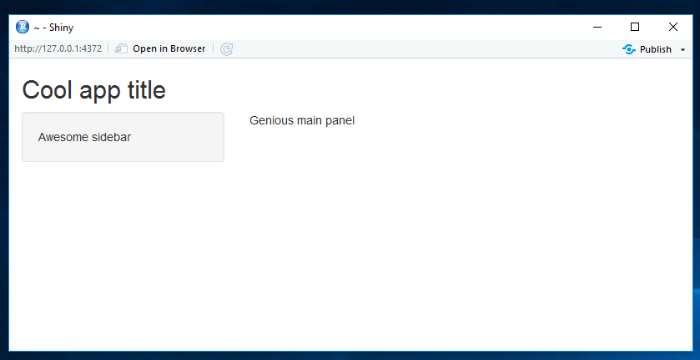
User interface: generic lay out
ui <- fluidPage(
titlePanel("Cool app title"),
sidebarLayout(
sidebarPanel("Awesome sidebar"),
mainPanel("Genious main panel")
)
)
## not displayed
ui <- fluidPage(
titlePanel("Extra"),
fluidRow(
column(6, … ),
column(6, … )
)
)
Notes:
the fluidpage was made so the items can change according to the browser size.
Column width = 12 max, so if you want to have multiple columns, the should add up to 12.

Slide 9
User interface: generic lay out
ui <- fluidPage(
titlePanel("Cool app title"),
sidebarLayout(
sidebarPanel("Awesome sidebar"),
mainPanel("Genious main panel")
)
)
In the UI you can add: text, images, widgets & R output
## not displayed
ui <- fluidPage(
titlePanel("Extra"),
fluidRow(
column(6, … ),
column(6, … )
)
)
Notes:
the fluidpage was made so the items can change according to the browser size.
Column width = 12 max, so if you want to have multiple columns, the should add up to 12.

Slide 10
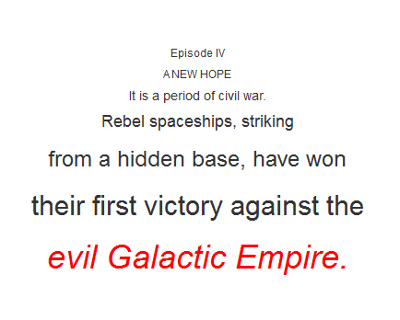
User interface: text
Shiny uses similar coding as HTML:
h1(), p(), div(), em(), strong(), …
Add text and change:
alignment, color, and size
mainPanel(
h6("Episode IV", align = "center"),
h6("A NEW HOPE", align = "center"),
h5("It is a period of civil war.", align = "center"),
h4("Rebel spaceships, striking", align = "center"),
h3("from a hidden base, have won", align = "center"),
h2("their first victory against the", align = "center"),
div(h1(em("evil Galactic Empire."), align = "center"), style = "color:red")
)

Slide 11
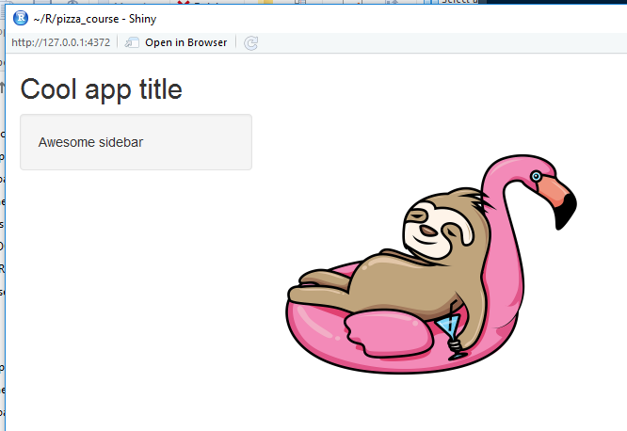
User interface: images
Add folder with name “www” to app.R directory
Put images in this folder & add code
Use the “Run App”-button, instead of ctrl+enter, to see the image
…
mainPanel(
img(src = "sloth_pixabay.png", height = 320, width = 320)
)
…

Slide 12
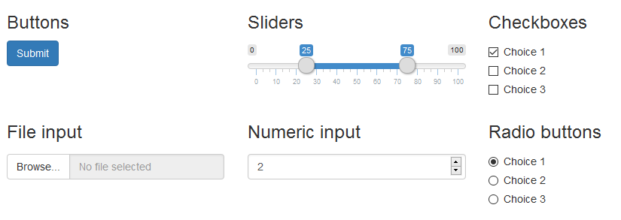
User interface: widgets
A widget is a web element a user can interact with
Many types are available, such as:

Slide 13
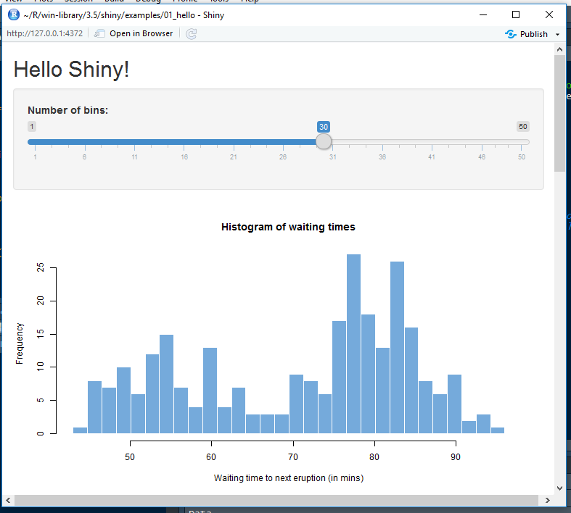
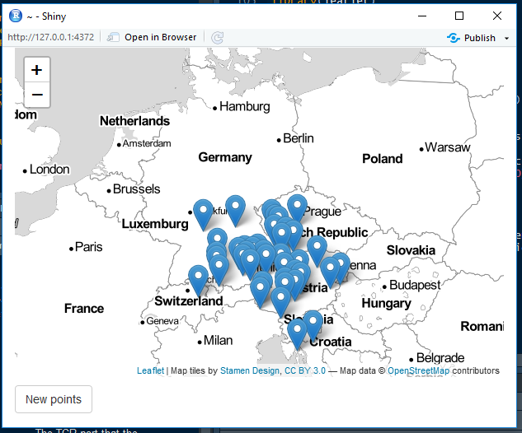
User interface: R output
Output you would see in your plot window in R, can be made visible in shiny
including leaflet maps (https://rstudio.github.io/leaflet/shiny.html)
## check out some examples with:
runExample()
runExample(example = “01_hello”)

Slide 14
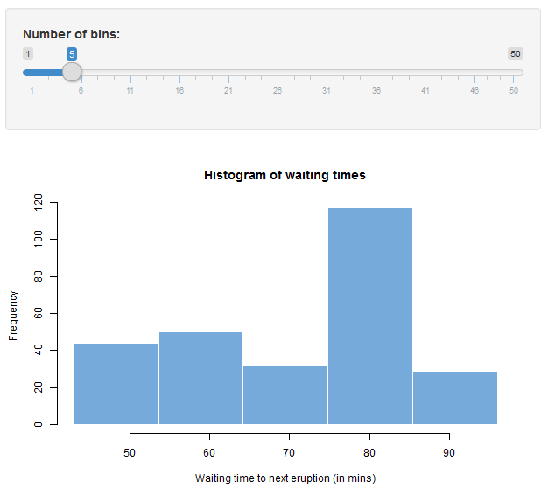
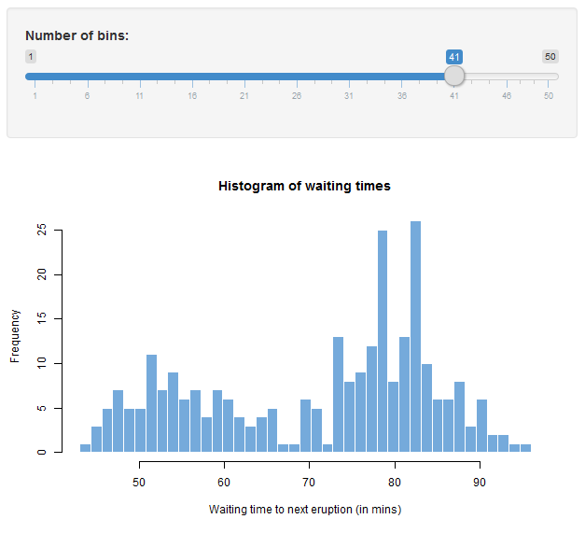
Server: widget input & R output
Notes:
Up till now you’ve seen the different display options. But when you make a shiny app, you usually want to do something with your data. For example: Someone moves a slider, and then something needs to happen. This is where the server section comes in.

Slide 15
Server: widget input & R output
# Define UI for app that draws a histogram ----
ui <- fluidPage(
# App title ----
titlePanel("Hello Shiny!"),
# Sidebar layout with input and output definitions ----
sidebarLayout(
# Sidebar panel for inputs ----
sidebarPanel(
# Input: Slider for the number of bins ----
sliderInput(inputId = "bins",
label = "Number of bins:",
min = 1,
max = 50,
value = 30)
),
# Main panel for displaying outputs ----
mainPanel(
# Output: Histogram ----
plotOutput(outputId = "distPlot")
)
)
)

Slide 16
Server: widget input & R output
# Define UI for app that draws a histogram ----
ui <- fluidPage(
# App title ----
titlePanel("Hello Shiny!"),
# Sidebar layout with input and output definitions ----
sidebarLayout(
# Sidebar panel for inputs ----
sidebarPanel(
# Input: Slider for the number of bins ----
sliderInput(inputId = "bins",
label = "Number of bins:",
min = 1,
max = 50,
value = 30)
),
# Main panel for displaying outputs ----
mainPanel(
# Output: Histogram ----
plotOutput(outputId = "distPlot")
)
)
)

Slide 17
Server: widget input & R output
# Define UI for app that draws a histogram ----
ui <- fluidPage(
# App title ----
titlePanel("Hello Shiny!"),
# Sidebar layout with input and output definitions ----
sidebarLayout(
# Sidebar panel for inputs ----
sidebarPanel(
# Input: Slider for the number of bins ----
sliderInput(inputId = "bins",
label = "Number of bins:",
min = 1,
max = 50,
value = 30)
),
# Main panel for displaying outputs ----
mainPanel(
# Output: Histogram ----
plotOutput(outputId = "distPlot")
)
)
)
# Define server logic required to draw a histogram ----
server <- function(input, output) {
# Histogram of the Old Faithful Geyser Data ----
# with requested number of bins
# This expression that generates a histogram is wrapped in a call
# to renderPlot to indicate that:
#
# 1. It is "reactive" and therefore should be automatically
# re-executed when inputs (input$bins) change
# 2. Its output type is a plot
output$distPlot <- renderPlot({
x <- faithful$waiting
bins <- seq(min(x), max(x), length.out = input$bins + 1)
hist(x, breaks = bins, col = "#75AADB", border = "white",
xlab = "Waiting time to next eruption (in mins)",
main = "Histogram of waiting times")
})
}

Slide 18
Server: widget input & R output
# Define UI for app that draws a histogram ----
ui <- fluidPage(
# App title ----
titlePanel("Hello Shiny!"),
# Sidebar layout with input and output definitions ----
sidebarLayout(
# Sidebar panel for inputs ----
sidebarPanel(
# Input: Slider for the number of bins ----
sliderInput(inputId = "bins",
label = "Number of bins:",
min = 1,
max = 50,
value = 30)
),
# Main panel for displaying outputs ----
mainPanel(
# Output: Histogram ----
plotOutput(outputId = "distPlot")
)
)
)
# Define server logic required to draw a histogram ----
server <- function(input, output) {
# Histogram of the Old Faithful Geyser Data ----
# with requested number of bins
# This expression that generates a histogram is wrapped in a call
# to renderPlot to indicate that:
#
# 1. It is "reactive" and therefore should be automatically
# re-executed when inputs (input$bins) change
# 2. Its output type is a plot
output$distPlot <- renderPlot({
x <- faithful$waiting
bins <- seq(min(x), max(x), length.out = input$bins + 1)
hist(x, breaks = bins, col = "#75AADB", border = "white",
xlab = "Waiting time to next eruption (in mins)",
main = "Histogram of waiting times")
})
}

Slide 19
Server: widget input & R output
# Define UI for app that draws a histogram ----
ui <- fluidPage(
# App title ----
titlePanel("Hello Shiny!"),
# Sidebar layout with input and output definitions ----
sidebarLayout(
# Sidebar panel for inputs ----
sidebarPanel(
# Input: Slider for the number of bins ----
sliderInput(inputId = "bins",
label = "Number of bins:",
min = 1,
max = 50,
value = 30)
),
# Main panel for displaying outputs ----
mainPanel(
# Output: Histogram ----
plotOutput(outputId = "distPlot")
)
)
)
# Define server logic required to draw a histogram ----
server <- function(input, output) {
# Histogram of the Old Faithful Geyser Data ----
# with requested number of bins
# This expression that generates a histogram is wrapped in a call
# to renderPlot to indicate that:
#
# 1. It is "reactive" and therefore should be automatically
# re-executed when inputs (input$bins) change
# 2. Its output type is a plot
output$distPlot <- renderPlot({
x <- faithful$waiting
bins <- seq(min(x), max(x), length.out = input$bins + 1)
hist(x, breaks = bins, col = "#75AADB", border = "white",
xlab = "Waiting time to next eruption (in mins)",
main = "Histogram of waiting times")
})
}
Notes:
Each output should have output from one of shiny’s render functions. The R expression between the {} of the render function, is something that is called at the start of the app, and when it needs to be updated. This updating proces is connected to the input$ statement.

Slide 20
Recap
UI
add an *Output function to show reactive objects in your app
add a widget to get your input from your app

Slide 21
Recap
UI
add an *Output function to show reactive objects in your app
add a widget to get your input from your app
Server
use a render* function to tell your app how to build the reactive objects
and don’t forget the curly braces
save the render* into the output list, as output$putNameHere <- ...
build an input$* into your render* expression to create reactivity

Slide 22
Recap
UI
add an *Output function to show reactive objects in your app
add a widget to get your input from your app
Server
use a render* function to tell your app how to build the reactive objects
and don’t forget the curly braces
save the render* into the output list, as output$putNameHere <- ...
build an input$* into your render* expression to create reactivity
Updates happen when
app starts
input changes
when the window size changes (automatic detection)

Slide 23
Exercises
An introduction to R shiny apps

Slide 24
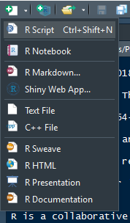
Exercise 1: setting up a standard app
install the shiny package (if you do not have it already)
set up a single file standard app via R studio (see picture)
give it a nice name
NB: put it in its own directory!
check out the structure of the generated file
see if you can change the amount of bins
1
2

Slide 25
Exercise 2: shiny examples
run runExample() to see which examples are out there
check out multiple examples to see some possibilities
see if you understand the code of 1 example
The code can be found in the library folder for shiny …\R\win-library\3.5\shiny\examples\01_hello\

Slide 26
Demo demo-app

Slide 27
Exploring shiny options

Slide 28
Selection...
Standard ggplot graph
Dynamic UI
Up- and download of files
Interactive plots
Dashboards functions
Leaflet maps
Shinycssloaders

Slide 29
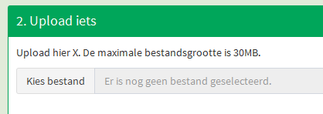
Uploading
## ui side:
...
fileInput("testInvoerbestand", NULL,
multiple = FALSE,
accept = c("text/csv",
"text/plain"),
buttonLabel = "Kies bestand",
placeholder = "Er is nog geen bestand geselecteerd."),
...
## server side:
testbestand <- reactive({
req(input$testInvoerbestand)
testfile <-inlezen(input$testInvoerbestand$datapath)
})
})

Slide 30
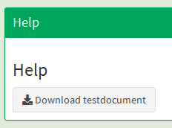
Downloading
## ui side:
...
downloadButton("testdocument", "Download testdocument")
...
## server side:
output$testdocument <- downloadHandler(
filename = function(){paste("Verberk Habitat en milieupreferenties macrofauna.pdf")},
content <- function(file){file.copy("documentatie/Verberk Habitat en milieupreferenties macrofauna.pdf", file)},
contentType = "application/pdf")
}

Slide 31
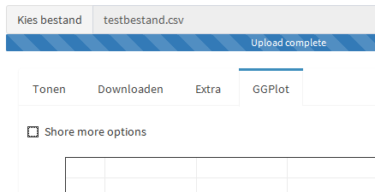
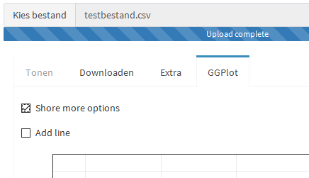
Dynamic ui’s
## https://shiny.rstudio.com/articles/dynamic-ui.html
## ui side:
...
tabPanel("GGPlot",
checkboxInput("more_options", "Shore more options"),
conditionalPanel(condition = "input.more_options == true",
checkboxInput("add_line", "Add meaningless line")),
...

Slide 32
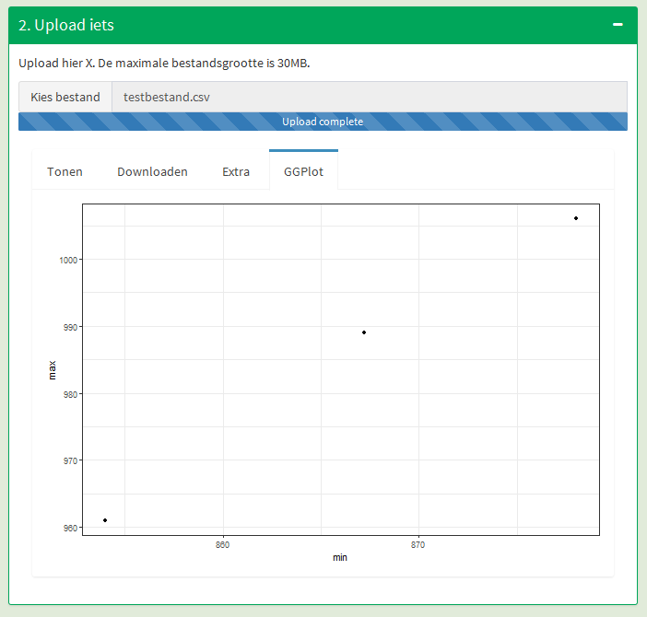
library(ggplot)
## ui side:
...
plotOutput(“name_here”)
...
## server side:
output$name_here <- renderPlot({
p <- ggplot(...) +
...
})

Slide 33
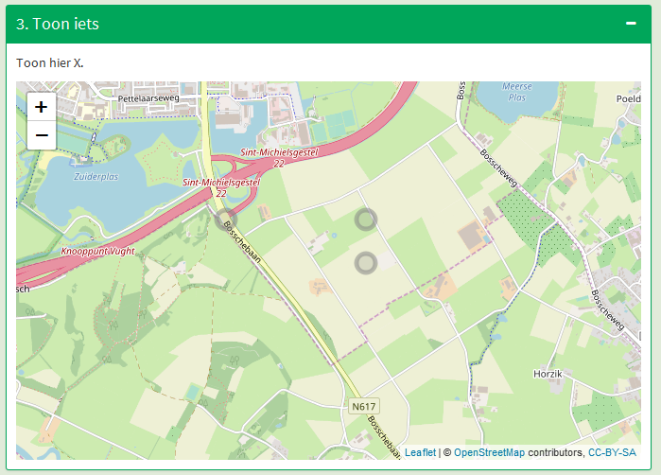
library(leaflet)
## ui side:
...
leafletOutput("leaflet_kaart")
...
## server side:
output$leaflet_kaart <- renderLeaflet({
req(testbestand())
df <- testbestand()
coordinates(df) <- (~locX+locY)
proj4string(df) <- CRS("+init=epsg:28992")
df.wgs <- spTransform(df, CRS("+proj=longlat +datum=WGS84"))
leaflet(df.wgs) %>%
addTiles() %>%
addCircleMarkers(color = "grey")
})

Slide 34
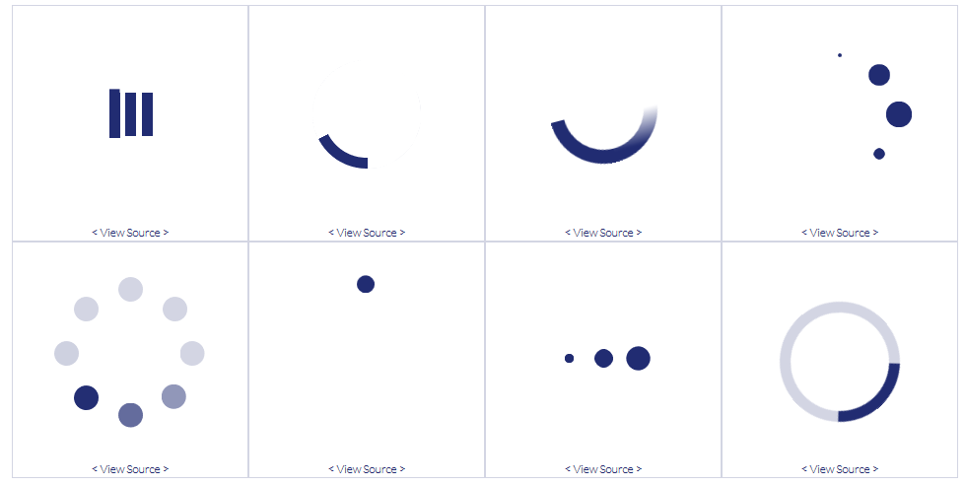
library(shinycssloaders)
## ui side:
...
withSpinner(plotOutput(...))
…
## https://projects.lukehaas.me/css-loaders/

Slide 35
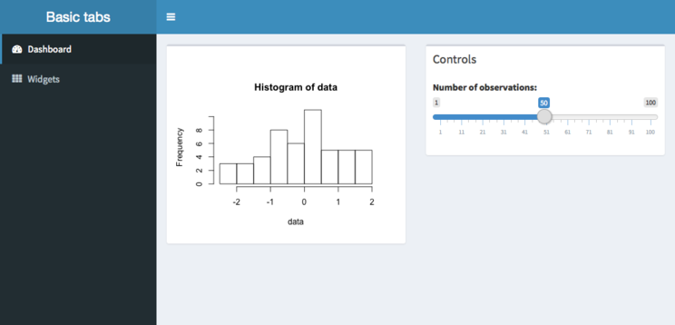
library(shinydashboard)
Header
Sidebar
Body
## https://rstudio.github.io/shinydashboard/index.html
Notes:
Easier way to make things look a bit more fancy.

Slide 36
library (plotly)

Slide 37
Recap
We’ve discussed standard functionality from Shiny:
Dynamic UI
Uploading files
Downloading of files
And implementations of other packages
ggplot
shinydashboard
leaflet
shinycssloaders
Other options are out there, check out https://shiny.rstudio.com/gallery/ for inspiration

Slide 38
Exercises
Exploring shiny options

Slide 39
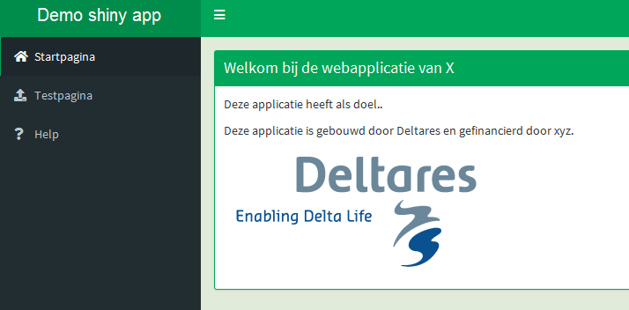
Exercise 3: The demo-app
Check out the demo-app that Willem Stolte demonstrated
See if you can find the code of the different functionalities the were just discussed
Play around with the app, e.g.:
Add widgets;
Adjust graphs;
Correct the map;
Add a download button

Slide 40
Debugging

Slide 41
Debugging options
using breakpoints or browser()
Visualize reactivity
run options(shiny.reactlog = T)
start app
press Ctr-F3 for reactivity log
See further: Debugging Shiny applications
Maybe this is of some use too? https://uomresearchit.github.io/r-shiny-course/goingfurther/reactive/

Slide 42
Testing Shiny apps - automatically
shinytest - R package
After setting up the test
Runs app
Takes snapshots
Compares (pixels in snapshot image) to testrun
see further: shinytest

Slide 43
Deploying your app
Via Rstudio account at shinyapps.io (https://rstudio.com/products/shinyapps/)
one click upload and deployment.
Free account (up to 5 active apps)
Paid - different schemes
@Deltares - local server with shinyserver software (open source).
ICT: installs shinyserver software and Linux packages (e.g. GDAL), test and production server, web certificate, proxy server.
You: install and update R packages, upload app files

Slide 44
Combine Rmarkdown & Shiny
https://beta.rstudioconnect.com/content/2671/Combining-Shiny-R-Markdown.html
R Markdown file that contains Shiny components
Include Markdown content in a Shiny app
Generate downloadable reports from Shiny app
Embed Shiny apps via their URLs in R Markdown document

Slide 45
R Markdown file that contains Shiny components
Shiny interactive document
https://bookdown.org/yihui/rmarkdown/shiny-start.html
Embedded shiny apps in Rmarkdown document
https://bookdown.org/yihui/rmarkdown/shiny-embedded.html
---
title: "Shiny Document"
output: html_document
runtime: shiny
---

Slide 46
Include Markdown content in a Shiny app
https://shiny.rstudio.com/gallery/including-html-text-and-markdown-files.html

Slide 47
Rplumber
PPT by Fedor Baart

Slide 48
Things I could address
Web API’s (5min)
Using a Web API (5min)
From function to API (10min)
Make your own Services (20min)
Next steps: Testing/Postman, Integration, Scaling/Cloud (5min)

Slide 49
Exercises
BYOD

Slide 50




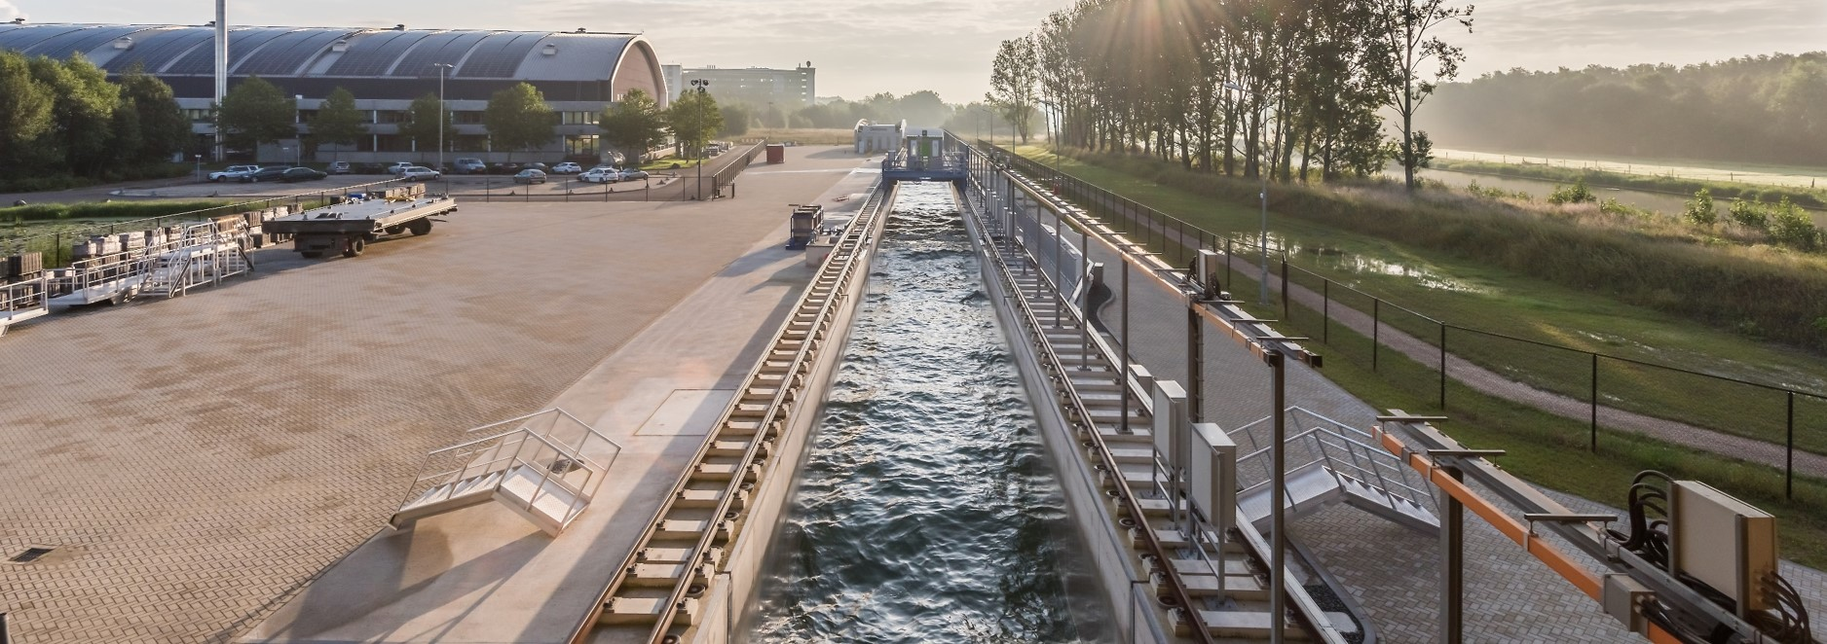

Contact
www.deltares.nl
linkedin.com/company/deltares
info@deltares.nl
facebook.com/deltaresNL
facebook.com/deltaresNL
linkedin.com/company/deltares
@deltares
@deltaresNL

